Slide 1

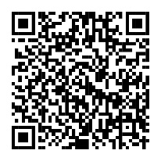

Annual Enrollment is almost here. It’s time to review your benefits.
Your Annual Enrollment window is <AE START DATE> until <AE END DATE>.
Now’s a great time to check your selections and make sure they fit your life. NetBenefits® will soon have everything you need to help you compare and enroll. You’ll also find personalized guidance to help you get the most from your benefits.
Scan to enroll or visit www.NetBenefits.com/healthbenefits
The trademarks and/or service marks appearing above are the property of FMR LLC and may be registered. The Fidelity Investments and pyramid design logo is a registered service mark of FMR LLC.
Fidelity Workplace Services LLC, 245 Summer Street, Boston, MA 02210
© 2026 FMR LLC. All rights reserved. 1271597.1.0
CLIENT LOGO

