Slide 1

Explore your
benefits options.
It’s time to enroll.
Annual Enrollment is now open
through <AE END DATE>.
CLIENT LOGO

Slide 2

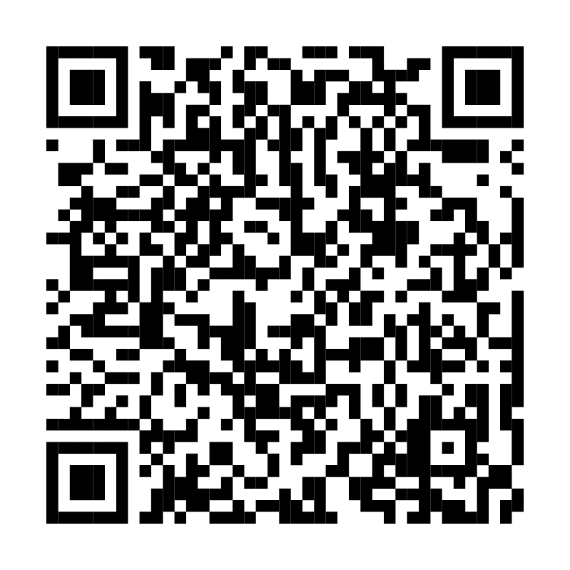
Take the opportunity to
review your selections.
Presorted
First-Class
U.S. Postage
PAID
Fidelity
Investments
PO Box 28012
Alburquerque, NM 87125
When you log into NetBenefits, a simple, guided experience will help you review, compare, and choose the options that best fit and support your total health and financial well-being.
You’ll also find personalized guidance to help you get the
most from your benefits.
If you have questions, please
call <FIDELITY BENEFITS
CENTER NAME> at <FIDELITY
BENEFITS CENTER PHONE #>.
Scan to enroll or visit
www.NetBenefits.com/
healthbenefits
Fidelity Workplace Services LLC, 245 Summer Street, Boston, MA 02210
© 2026 FMR LLC. All rights reserved. 1216388.2.0

