Slide 1

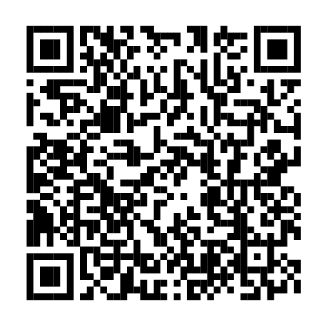
Explore your benefits options.
It’s time to enroll.
Annual Enrollment is now open through <AE END DATE>.
When you log into NetBenefits®, a simple, guided experience will help you review, compare, and choose the options that best fit and support your total health and financial well-being.
Scan to enroll or visit
www.NetBenefits.com/healthbenefits
The trademarks and/or service marks appearing above are the property of FMR LLC and may be registered. The Fidelity Investments and pyramid design logo is a registered service mark of FMR LLC.
Fidelity Workplace Services LLC, 245 Summer Street, Boston, MA 02210
© 2026 FMR LLC. All rights reserved.1216388.2.0
CLIENT LOGO

