Slide 1

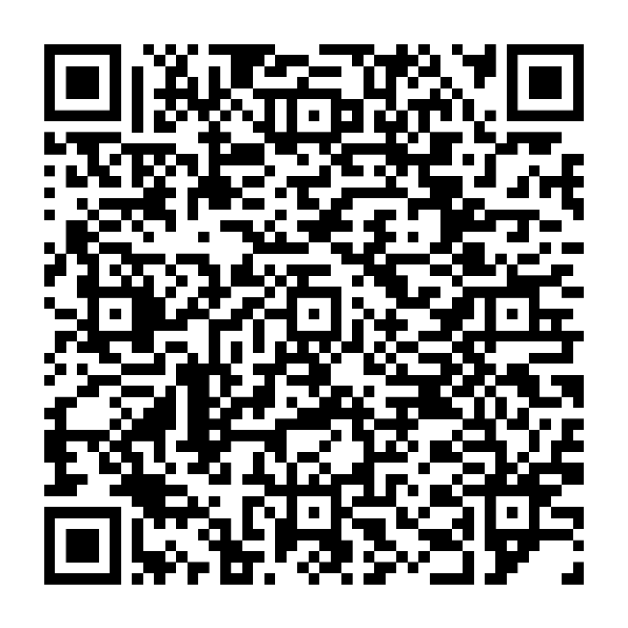
JOIN OUR VIRTUAL WATCH PARTY
Make the most of your money and create a financial legacy
Wednesday, February 12, 2025 2 p.m.–3 p.m. ET
Fidelity pros will share insights and resources to help you take your money to the next level—as seen in our mainstage panel discussion at Invest Fest 2024.
Scan QR code or visit Fidelity.com/BlackLegacy to RSVP
Investing involves risk, including risk of loss.
The Fidelity Investments logo is a registered service mark of FMR LLC.
Fidelity Brokerage Services LLC, Member NYSE, SIPC, 900 Salem Street, Smithfield, RI 02917
© 2025 FMR LLC. All rights reserved. 1181863.1.0

