Slide 1
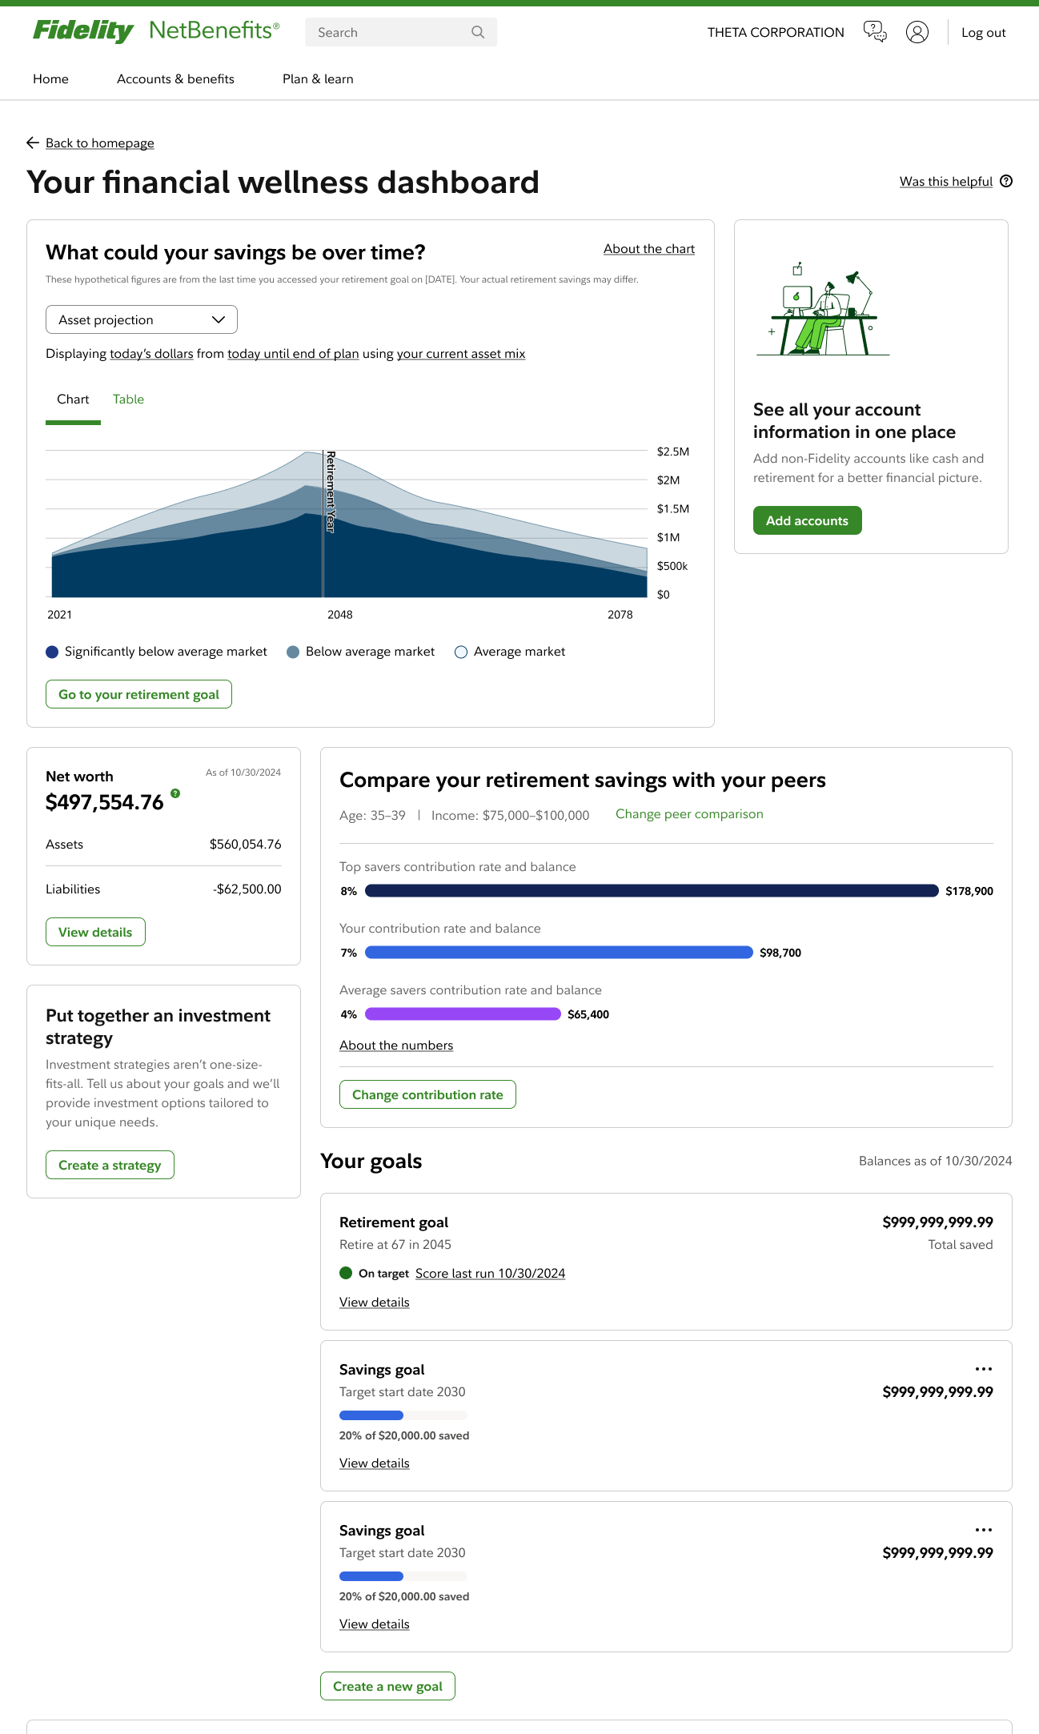

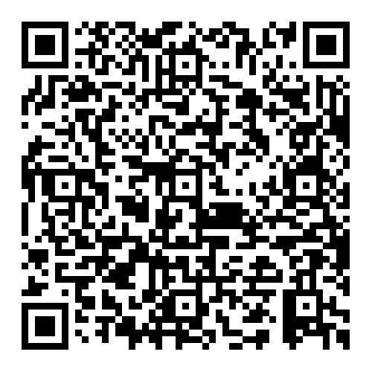
Your financial wellness dashboard
Work toward your goals
Set goals that matter to you,
track progress, and celebrate milestones along the way
Take charge of your money with financial help that evolves with you
Explore financial wellness Find resources that help you manage your money in ways
that work for you
Explore simple tools, useful tips, and help when you need it—all in one place on NetBenefits®.
Plan for the future
Make confident steps toward the future you want with simple tools and personalized insights
SCAN to get started. Hover your phone’s camera over the code.
No app needed.

