Slide 1

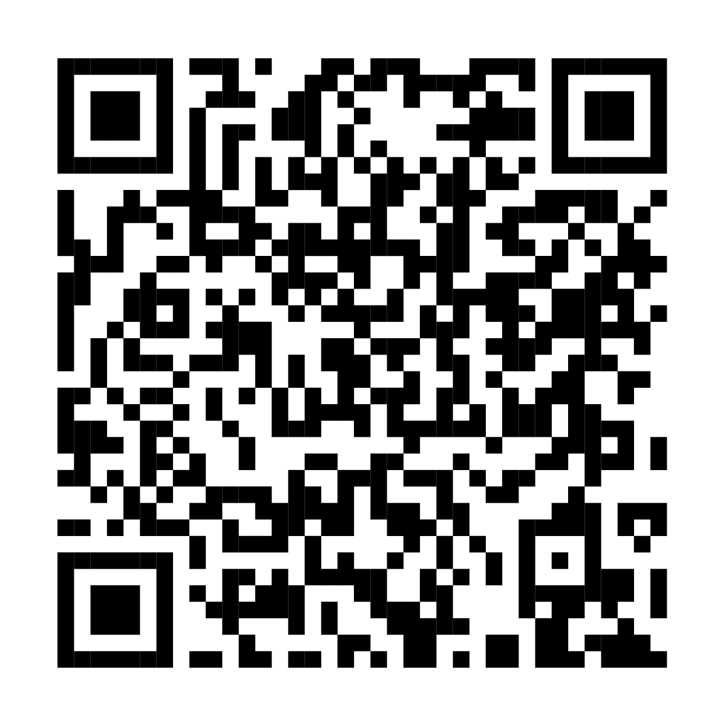
Choose an HSA-eligible
health plan and open
a Fidelity HSA®
This annual enrollment, make the most of your health care spending. With a Health Savings Account (HSA), you can save money on taxes*, the money is yours to keep, and you have the flexibility to spend your funds now or invest them for the future.
Scan this code or visit
Fidelity.com/HSA for more info.
With respect to federal taxation only. Contributions, investment earnings, and distributions may or may not be subject to state taxation. See your tax professional for more information on the state tax implications of HSAs.
Fidelity HSA and the Fidelity Investments logo are registered service marks of FMR LLC.
Fidelity Brokerage Services LLC, Member NYSE, SIPC, 900 Salem Street, Smithfield, RI 02917
© 2025 FMR LLC. All rights reserved.
1098282.4.0
CLIENT LOGO

