Slide 1
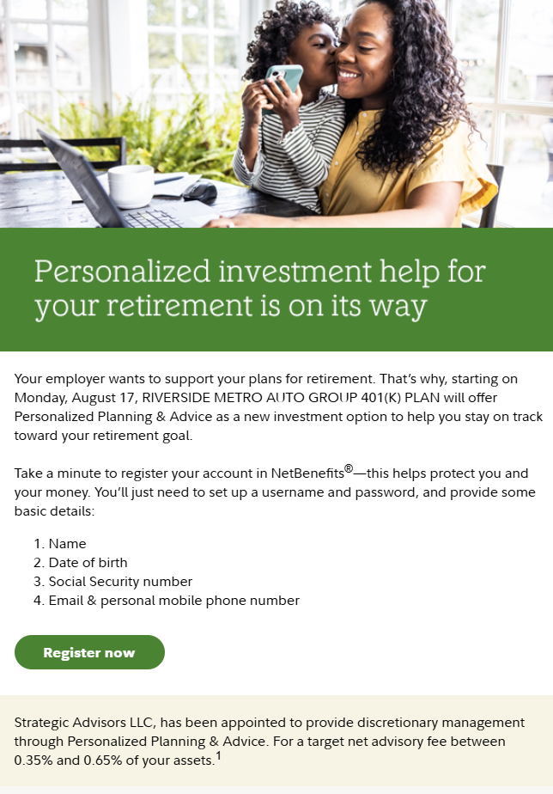
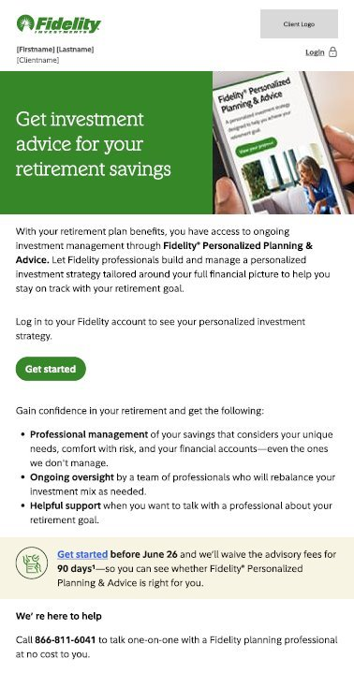
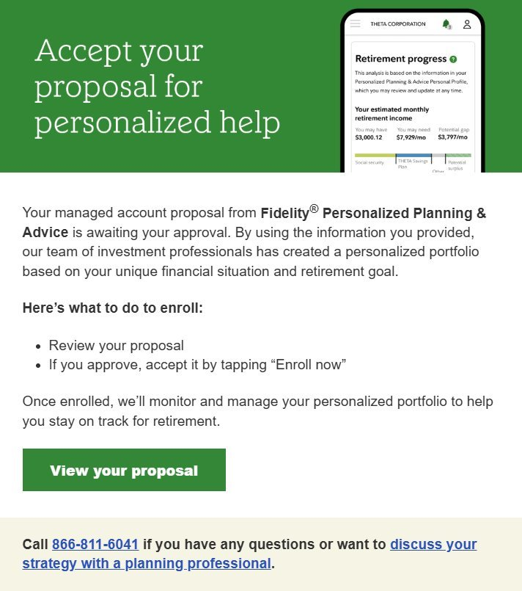
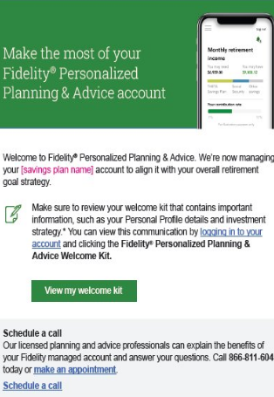
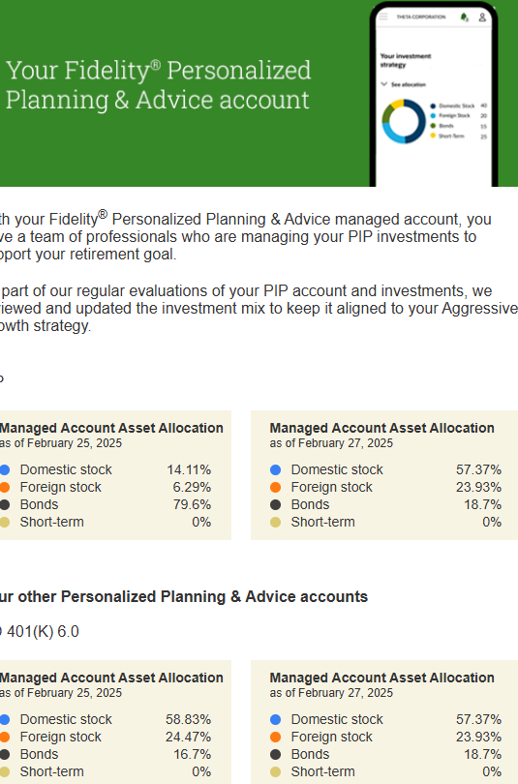
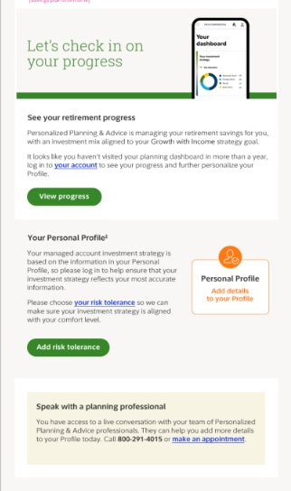
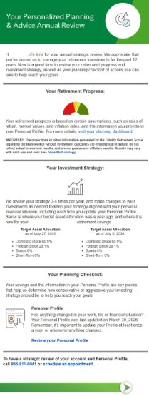
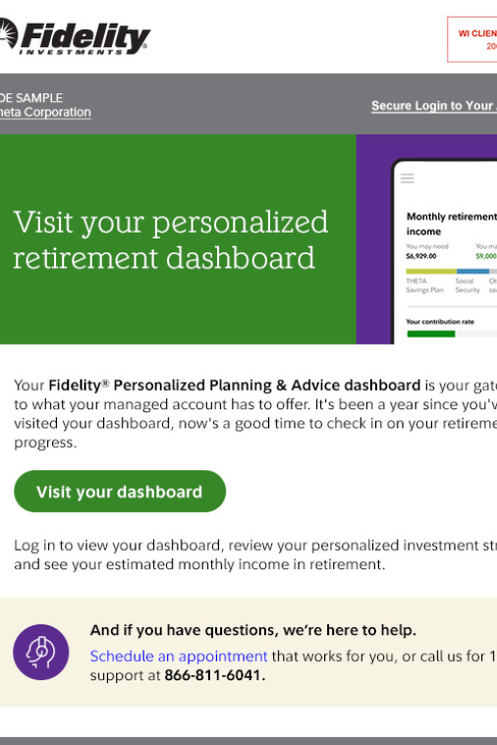
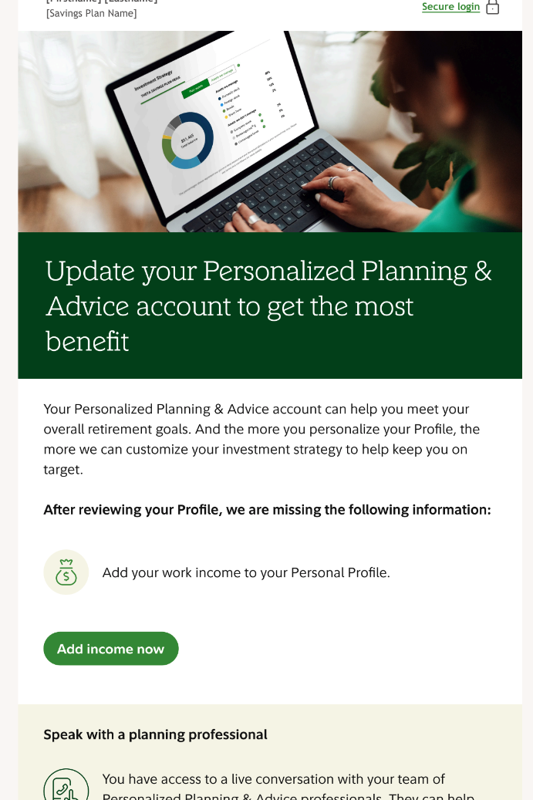
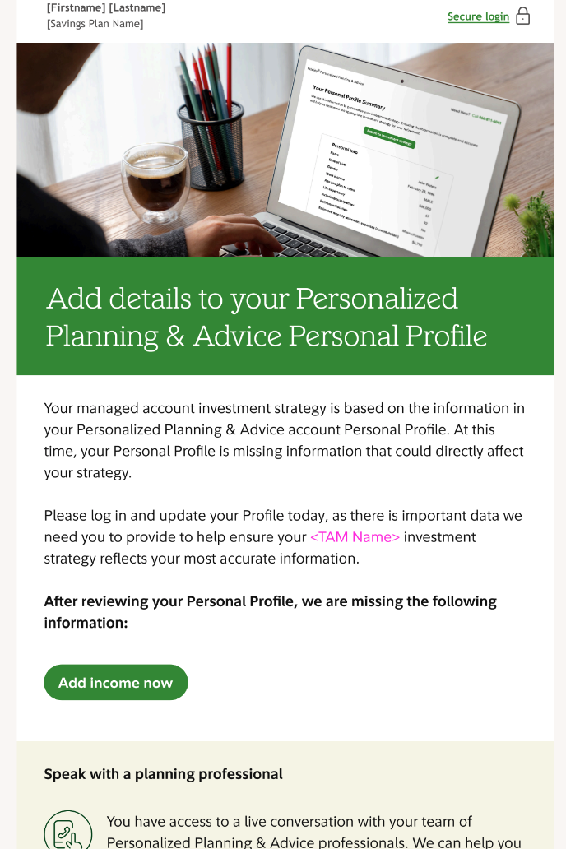
Fidelity® Personalized Planning & Advice Centrally deployed campaigns for participants
ELIGIBLE |  |  | ENROLLED
Awareness | Consideration |  | Onboard | Personalize & Maximize
Activation | PP&A Awareness | Re-engagement | Onboarding | Investment Strategy | Quarterly Check-In | Anniversary | Engagement Triggers | Personal Profile Reminders | Low Personalization Reminder
Description: Announces the availability of the new PP&A service to plan participants after a plan adds PP&A as a plan feature | Description: To provide awareness and education on what a managed account offers and to consider if a managed account is right for them | Description: Re-engages participants that started their Personal Profile or generated a Proposal to return and learn more or complete their enrollment | Description: To welcome participants and promote personalizing their Personal Profile and visiting their PP&A planning dashboard | Description: To inform participants of their personalized investment strategy and keep them aware of any account reviews or changes as part of on-going management | Description: To engage participants quarterly with a snapshot of their plan, drive planning dashboard visits, and helping ensure their Profile is kept up to date | Description: To provide participants with their retirement readiness score and target asset allocation compared to the previous year | Description: To target and help ensure participants are engaging with and making the most of their managed account | Description: Targets participants who have not yet personalized their Profile | Description: Targets participants ​ who are considered low personalized ​ within their Personal Profile​
Opt-Out Available? Yes | Opt-Out Available? Yes | Opt-Out Available? Yes | Opt-Out Available? No | Opt-Out Available? No | Opt-Out Available? No | Opt-Out Available? No | Opt-Out Available? No | Opt-Out Available? Yes | Opt-Out Available? Yes
Format: Email, print backup for touch 1 and 2 | Format: Email only | Format: Email only | Format: Email, print backup for touch 1 only | Format: Email, print backup | Format: Email, print backup | Format: Email, print backup | Format: Email only | Format: Email, print backup | Format: Email,​ print backup​
Time/Cadence: ~35 prior days prior to the plan going live with PP&A | Time/Cadence: Annually | Time/Cadence: Ongoing trigger | Time/Cadence: Responsive, upon enrollment, touches sent every week | Time/Cadence: Responsive, sent after every rescore and/or Profile update | Time/Cadence: Sends quarterly | Time/Cadence: Responsive, sent to all participants on their anniversaries with the service | Time/Cadence: Responsive, sent to participants who have not visited their PP&A dashboard or updated their Personal Profile within the past year | Time/Cadence: Quarterly (March, June, September, & December) | Time/Cadence: Annual (December)​
Options: 4 touches | Options: 3 touches | Options: 2 touches | Options: N/A | Options: N/A | Options: N/A | Options: N/A | Options: N/A | Options: N/A | Options: N/A

