Slide 1
Personalized Planning & Advice
Activation campaign
April 2026

Slide 2
Agenda
01
Campaign Overview
02
Email and Print Samples
03
Sample Campaign Timeline
04
Destination Pages
05
NetBenefits® Experience

Slide 3
Campaign Overview

Slide 4
Campaign Overview
Our goal
Drive awareness and consideration of Personalized Planning & Advice as a new plan feature
Educate participants on managed account features to help them determine the right investment solution based on their preferences
When
Starting with PP&A plan rollouts in April 2026.
Pricing Discount
Pricing discount available if plan chooses to offer one
Discount percentage varies by market
Audience
All participants eligible for PP&A at the time of plan feature being added
How we’ll communicate
This multi-channel campaign includes e-mail, print back-up, NetBenefits® messaging, and mobile in-app notification

Slide 5
Email and Print Samples

Slide 6
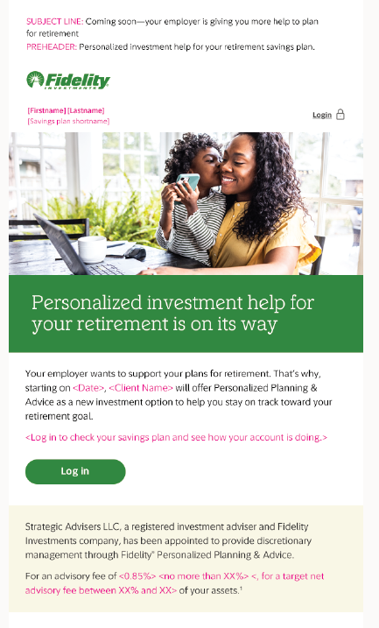
Touch 1
Change Notice (Core Market Only)
Sent 35 days prior to launch of PP&A to their plan
  Sent automatically to lower market clients
  Must be scheduled for Upper market clients
Makes participants aware of the new PP&A service coming soon
Links to the NetBenefits® to drive digital engagement

Slide 7
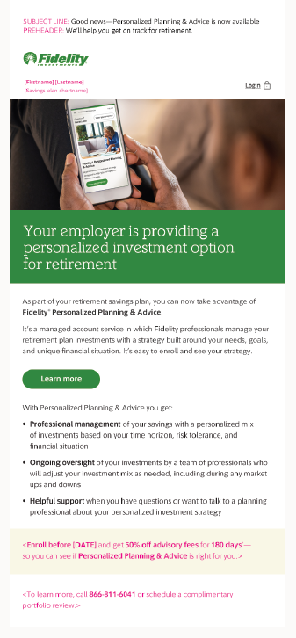
Touch 2
Launch announcement
Sent 7 days after the launch of PP&A to the plan
Makes participants aware that PP&A is now available as an investment option
Drives to the PP&A eligible landing for additional education on managed account features
Also includes Workplace planning phone number and digital appointment scheduler for one-on-one support

Slide 8
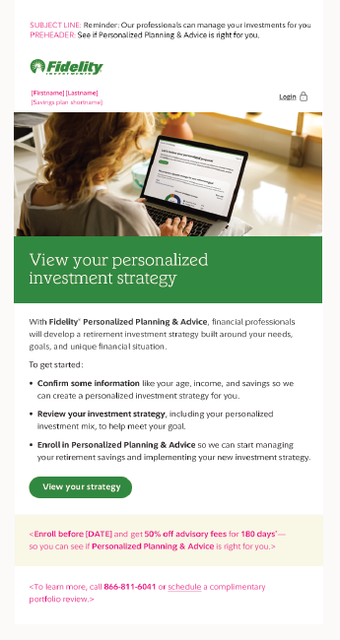
Touch 3
Personalized proposal
Sent 14 days after launch of PP&A to their plan or 14 days from fee discount deadline date
Takes participants through the digital experience to see their personalized investment strategy and proposal
Drives to the PP&A Eligible Landing Page
Also includes Workplace planning phone number and the digital appointment scheduler

Slide 9

Touch 4
Reminder
Sent 3 days from deadline date
Participants will only receive this touch if eligible for a fee discount
Final reminder to participant of discount deadline and if they want to take advantage of it to see if a managed account is right for them
Drives to the PP&A eligible landing page
Also includes Workplace planning phone number and the digital appointment scheduler

Slide 10
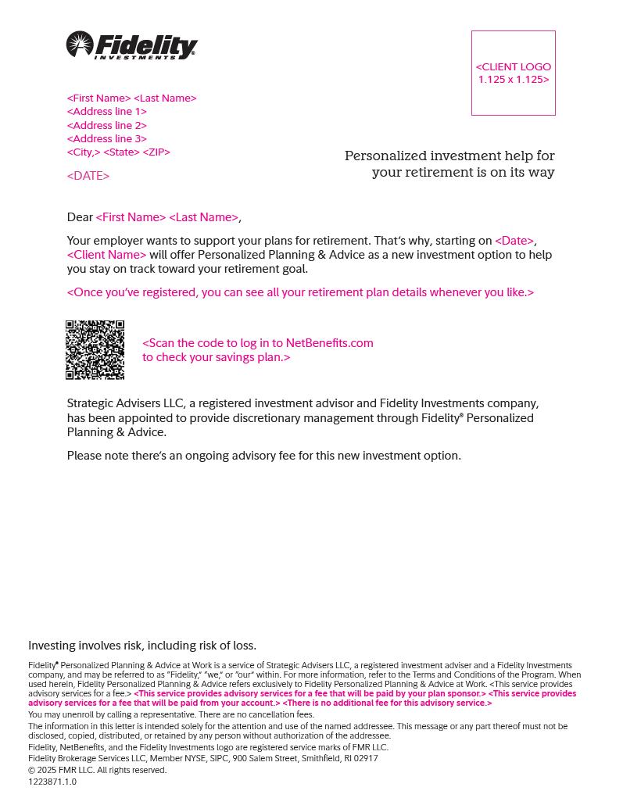
Print Back-Up for Touch 1

Slide 11
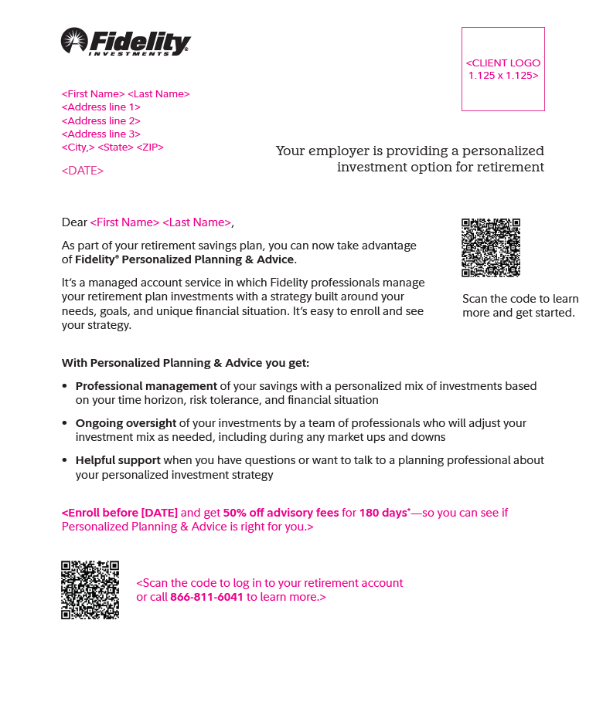
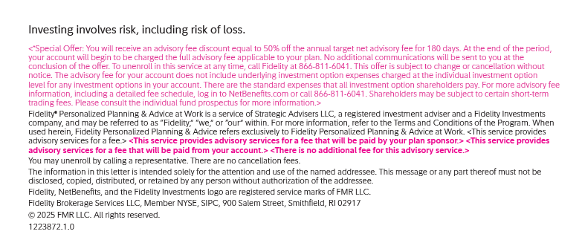
Print Back-Up for Touch 2

Slide 12
Sample Campaign Timeline

Slide 13


Sample Campaign Timeline
3
4
Personalized Proposal
14 days
before deadline
Deadline Reminder
3 days
before deadline
Offer Deadline Date
1
2
Change Notice
35 days
before live date
PP&A Plan
Live Date
Launch Announcement
7 days
after live date
3
Personalized Proposal
14 days
after live date
Plans that are not including discount offer will receive 3 total touchpoints as no deadline reminder needed

Slide 14
Destination Pages

Slide 15
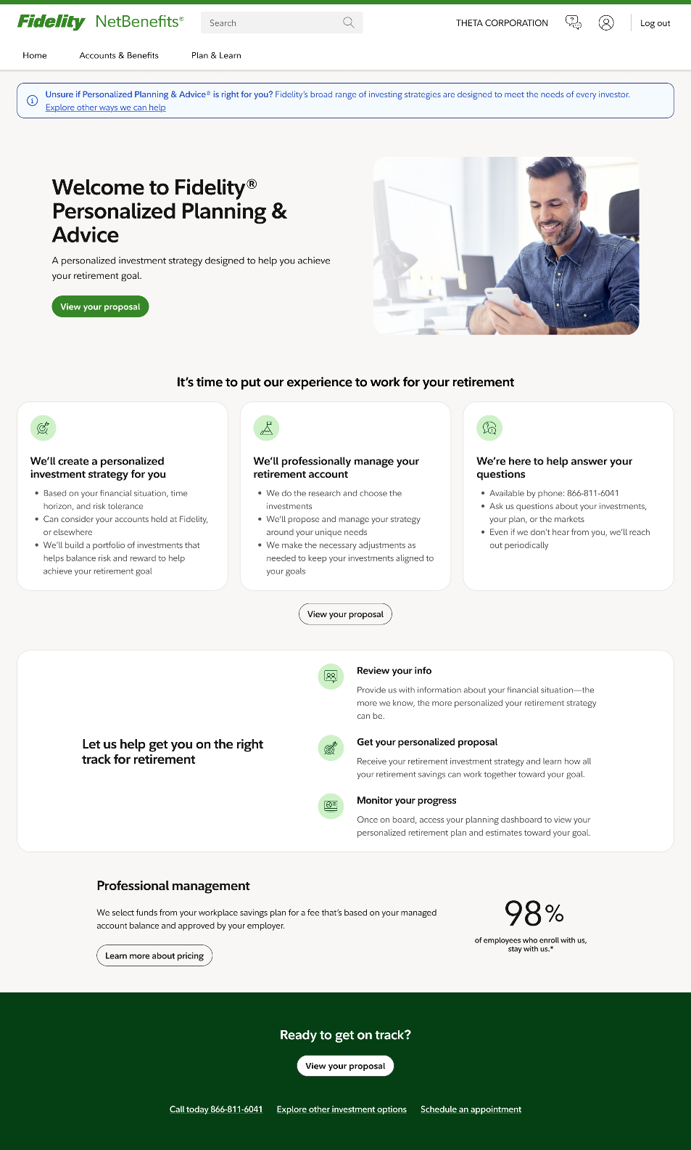
PP&A Eligible Landing Page

Slide 16
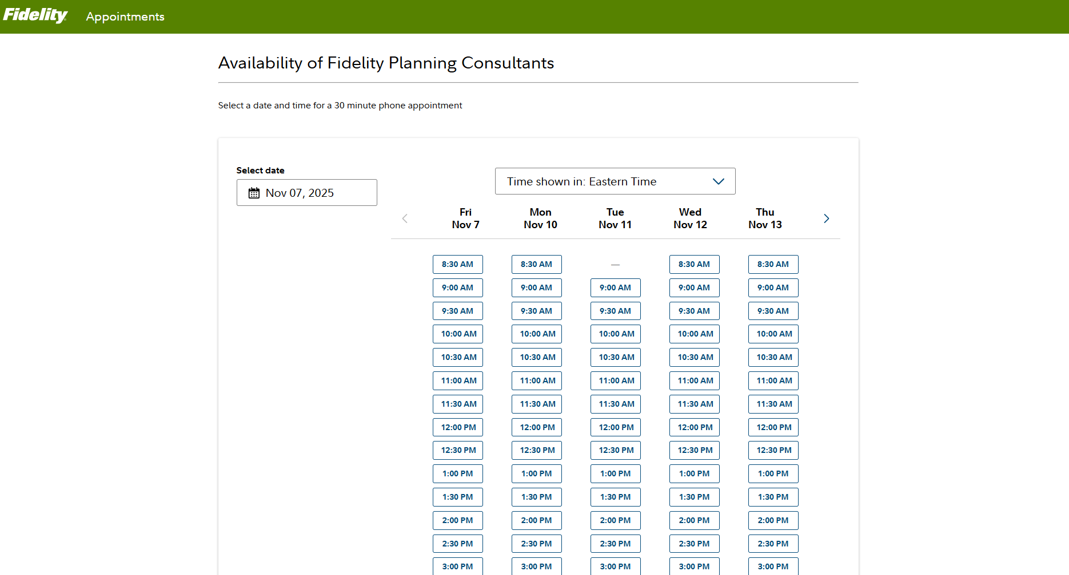
Digital Appointment Scheduler

Slide 17
NetBenefits® Experience

Slide 18

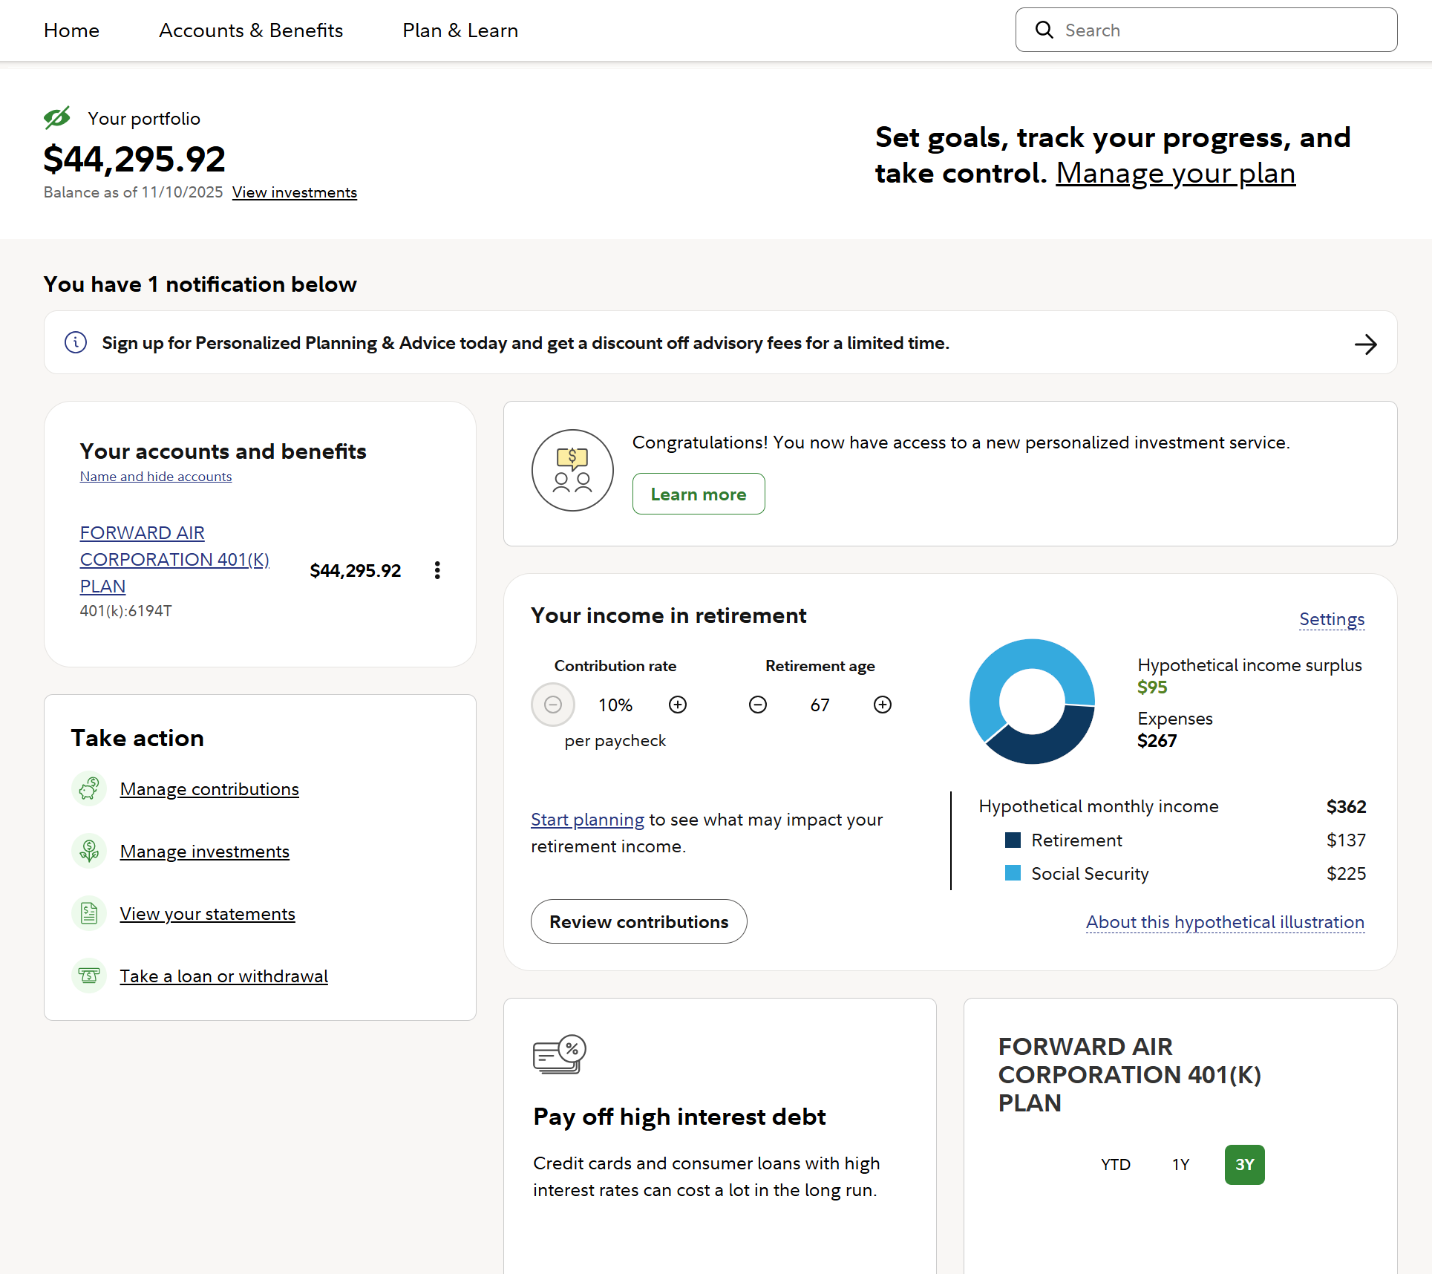
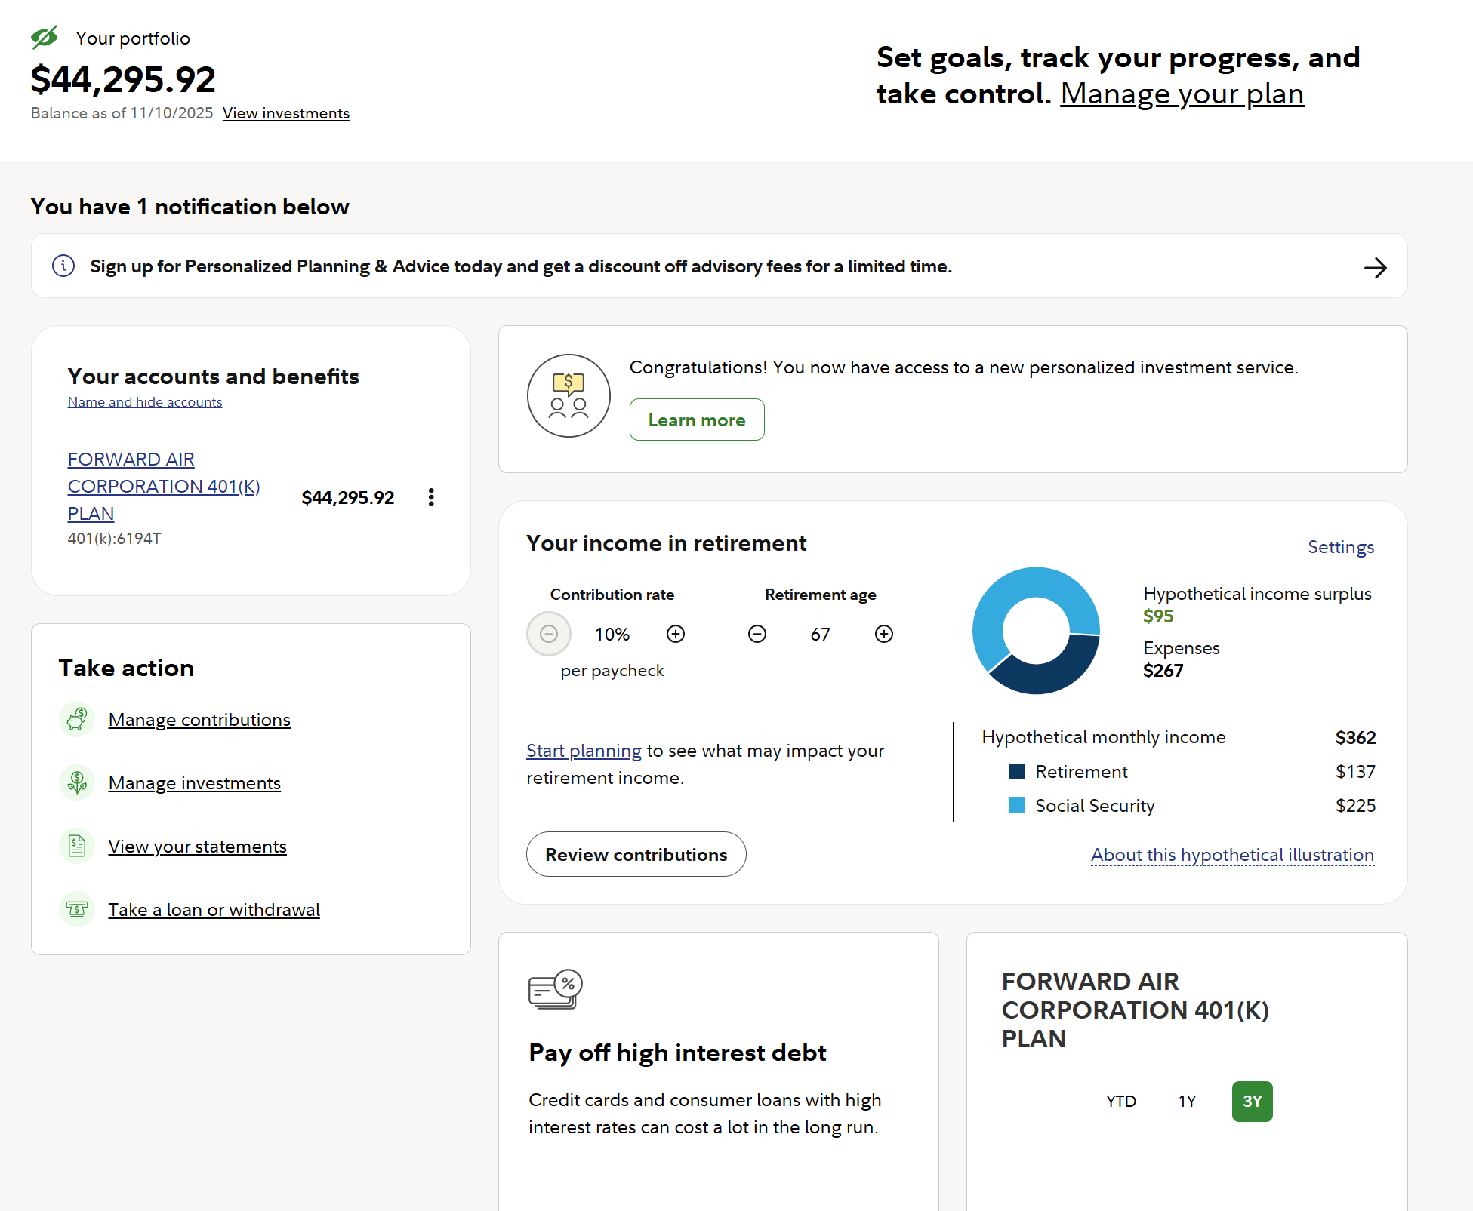
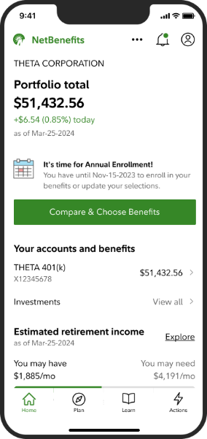
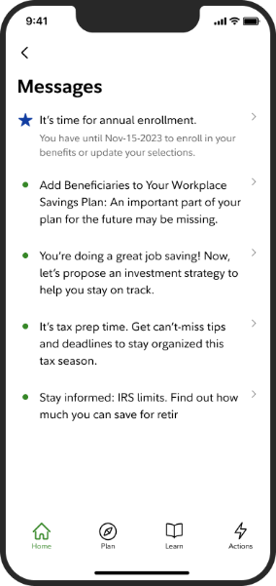
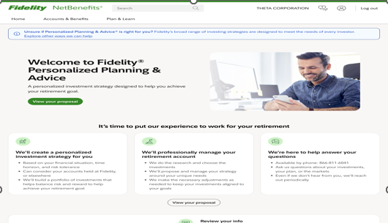
NetBenefits® Integrated Messaging
Notification
Displays on the NetBenefits® homepage as well as in mobile
NetBenefits® Homepage
PP&A Eligible Landing Page
Sign up for Personalized Planning & Advice today and get a discount off advisory fees for a limited time.
Notes:
this mid is new to plan - ee68c1dc450a8830db2001d27d0008aa33
HP banner, ELP, and notification

Slide 19

Important information
Screenshots are for illustrative purposes only.
For institutional and plan sponsor or investment professional use only.
Investing involves risk, including risk of loss.
Fidelity® Personalized Planning & Advice at Work is a service of Strategic Advisers LLC, a registered investment adviser and a Fidelity Investments company, and may be referred to as "Fidelity," "we," or "our" within. For more information, refer to the Terms and Conditions of the Program. When used herein, Fidelity Personalized Planning & Advice refers exclusively to Fidelity Personalized Planning & Advice at Work. This service provides advisory services for a fee.
Fidelity Brokerage Services LLC, Member NYSE, SIPC, 900 Salem Street, Smithfield, RI 02917
© 2025 FMR LLC. All rights reserved.
1234779.1.0

